Slide 1
BMT AND THALASSAEMIA
DR. MD. SALAHUDDIN SHAH
MBBS, DCP, MCPS, FCPS (Haematology)
IHTC Fellow, UNC, USA
Fellowship in Haematology & BMT/ Stem
Cell Transplantation, Australia
Haematologist & BMT Physician
ASSOCIATE PROFESSOR
Department of Haematology
Bangabandhu Shiekh Mujib Medical University

Slide 2
Introduction
Despite the remarkable improvements in medical therapy for haemoglobinopathies, hematopoietic stem cell transplantation (HSCT) still remains the only available curative approach.

Slide 3
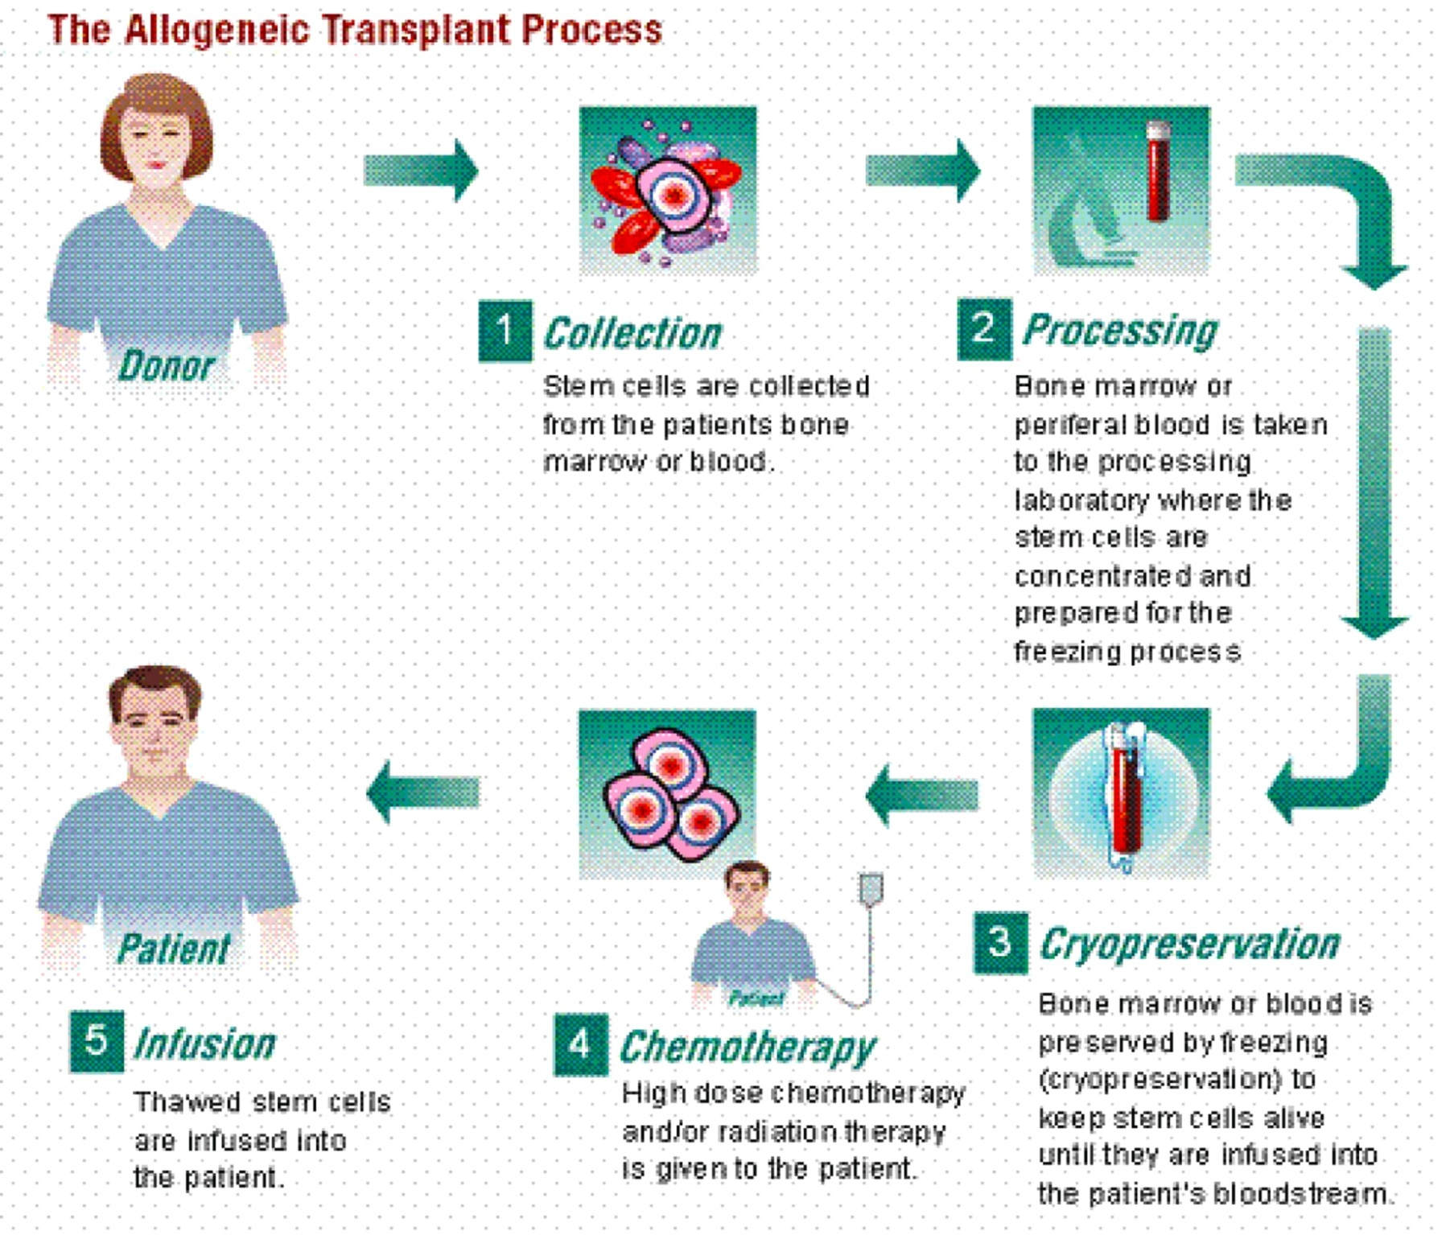

Slide 4
Overview of transplantation
Accepted and experimental transplantation approaches in thalassemia
HLA identical sibling transplant | Accepted
HLA well matched unrelated donor transplant | Accepted
HLA identical sibling cord blood transplant | Accepted
HLA matched unrelated cord blood transplant | Experimental
HLA mismatched related donor transplant | Experimental

Slide 5
1980s and early 1990s
HSCT- accepted as routine clinical practice
More than 3000 HSCTs were performed worldwide (Angelucci 2010)

Slide 6
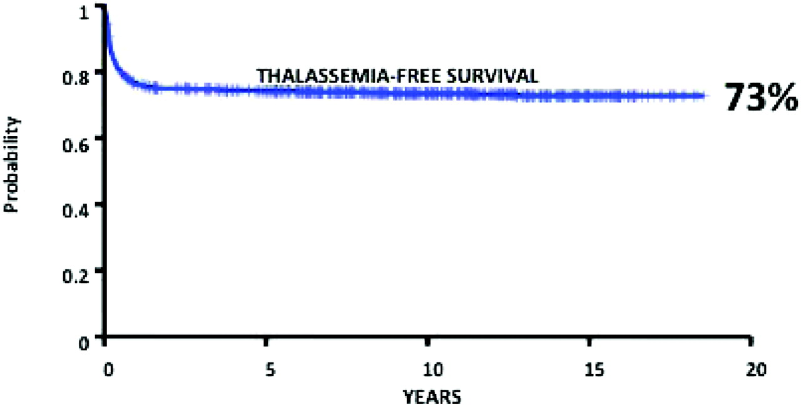
Results of 900 consecutive unselected HSCTs for Thalassemia performed in Pesaro since 1982.
Emanuele Angelucci Hematology 2010;2010:456-462
©2010 by American Society of Hematology
Notes:
Results of 900 consecutive unselected HSCTs for thalassemia performed in Pesaro since 1982. Reprinted with permission from Angelucci and Baronciani.10

Slide 7
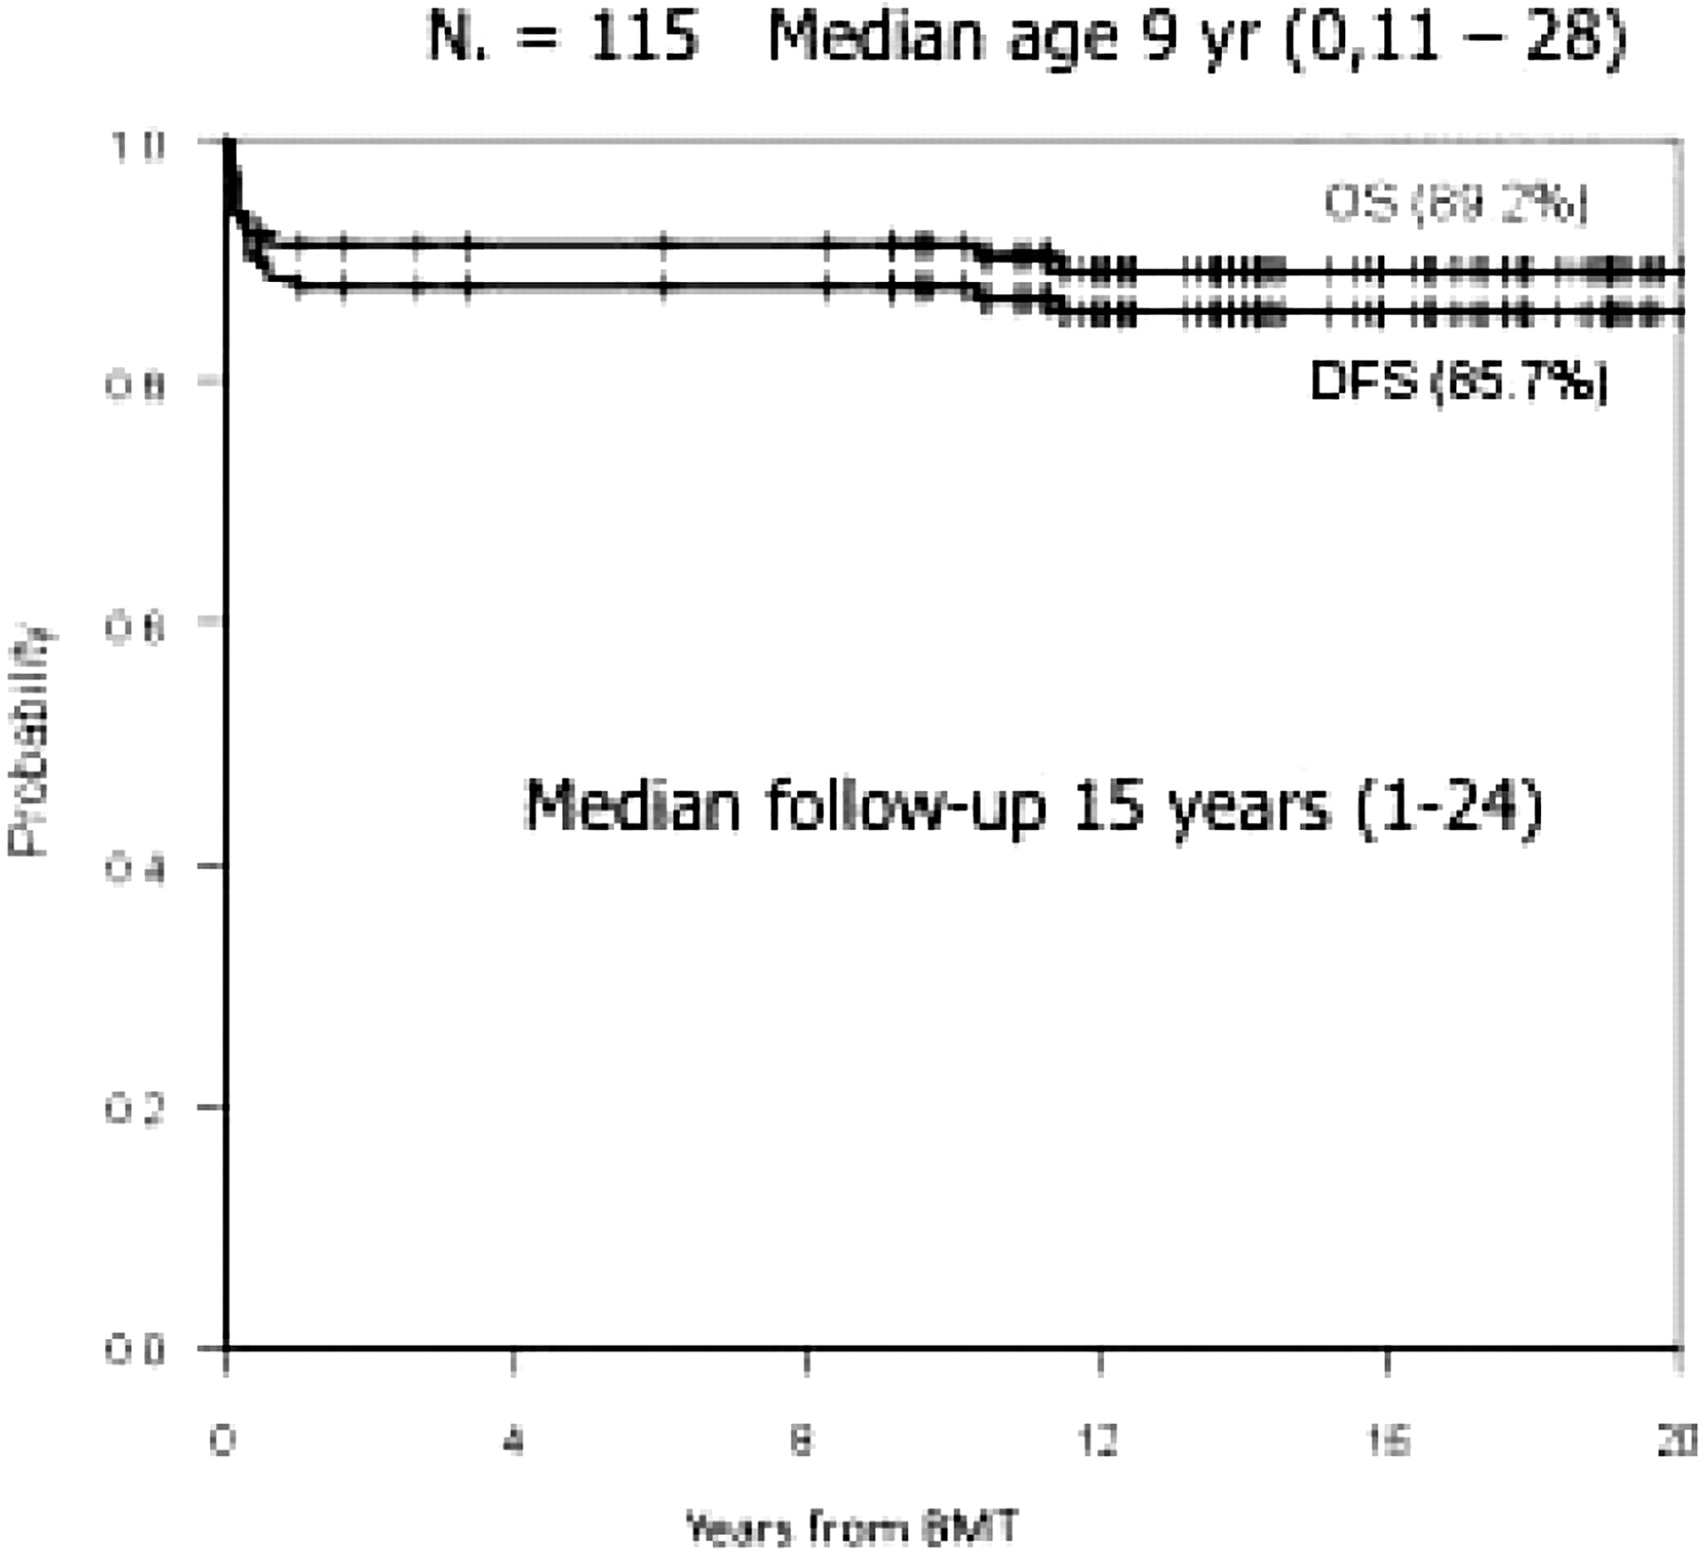
Results of 115 consecutive HSCTs for thalassemia in Pescara since 1984.
Emanuele Angelucci Hematology 2010;2010:456-462
©2010 by American Society of Hematology
Notes:
Results of 115 consecutive HSCTs for thalassemia in Pescara since 1984. Reprinted with permission from Di Bartolomeo et al.11

Slide 8
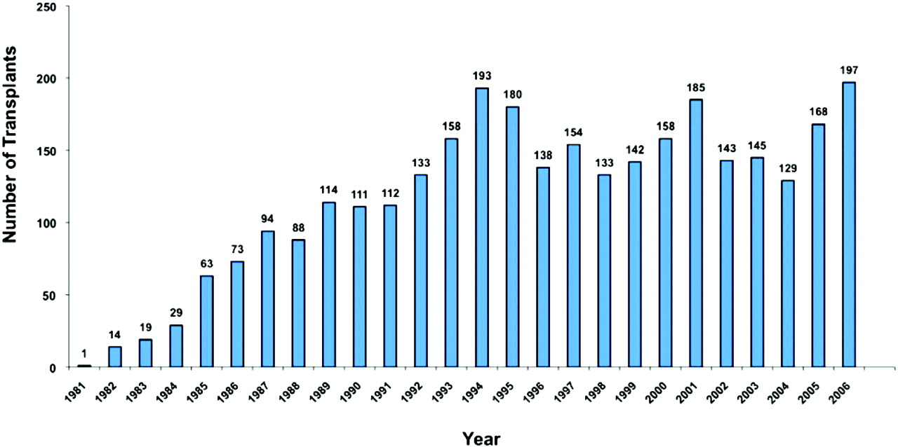
HSCTs in thalassemia by years.
Emanuele Angelucci Hematology 2010;2010:456-462
©2010 by American Society of Hematology
Notes:
HSCTs in thalassemia by years. Data from the Hemoglobinopathies Registry of the European Group for Blood and Marrow Transplantation. Reprinted with permission from Angelucci and Baronciani.10

Slide 9
Factors that must be considered for individual decision making about HSCT for thalassemia

Slide 10
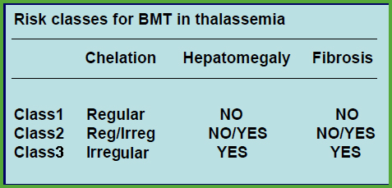
Categories of risk and Lucarelli Classification
Lucarelli G et al. N Engl J Med 1990

Slide 11
Expected probability of overall survival and thalassaemia free survival after HSCT in thalassaemia major
CLASS | OVERALL SURVIVAL | THALASSAEMIA-FREE SURVIVAL
Class 1 | 95% | 90%
Class 2 | 85% | 80%
Class 3 | 75-80% | 65-70%
Adult | 70-75% | 75%

Slide 12
New Stratification for High Risk Class 3 Patients
Definition
Older patients
Age > 10 yrs
Hepatomegaly
Liver > 3 cms below right costal margin

Slide 13
High Risk Class 3 Patients (Age > 10 yrs) Pretransplant Management Program
Hypertransfusion in order to decrease erythroid expansion especially to decrease spleen size
Regular iron chelation for at least 6-12 months
Hydroxyurea (Hb F enhancer) in order to decrease erythroid expansion: 20 mg/kg/day for at least 6-12 months
Sodani P et al. Blood 2004
Hongeng S et al. Am J Hematol 2007

Slide 14
Hematological 2014

Slide 15
HSCT in children and adolescents
Young TM patients with an available HLA identical sibling should be offered HSCT as soon as possible before development of iron overload and iron-related tissue damage.
HLA genoidentical CB and BM are equally effective stem cell sources.
PBSCT should be avoided because of the increased risk of cGVHD.

Slide 16
HSCT in adult patients
HSCT in adults who have been well-chelated since infancy should be offered within controlled trials.
Assessment of clinical condition according to the risk score and adequate transfusions/chelation regimen are the major issues to be evaluated before deciding to perform HSCT.

Slide 17
Recent reports on matched sibling donor HSCT in children and adults with thalassaemia major

Slide 18
Use of donors other than an HLA matched sibling
HSCT from an HLA-mismatched family member in TM should still be considered an experimental approach and has to be conducted in the context of well-designed controlled trials.
HLA typing of the entire family is advisable. HSCT from an HLA-phenotypically-identical donor is an option to be performed in expert centers

Slide 19
Matched unrelated donors
If a well-matched UD is available, allogeneic HSCT is a suitable option for a child with life-long control of iron overload and absence of iron-related tissue complications.
The UD must be selected using high-resolution molecular typing for both HLA class I and II loci, and according to stringent criteria of compatibility with the recipient.

Slide 20
Unrelated cord blood transplantation
Unrelated cord blood transplantation must be performed in the context of well-controlled clinical trials in centers with specific UCBT programs.

Slide 21
Transplant management Conditioning regimen
MAC without irradiation should always be used for standard transplantation.
Reduced toxicity regimens are under investigation and are to be used in the context of clinical trials

Slide 22
The sequential administration of hydroxyurea, followed by PTIS and subsequently an RTC regimen of Flu, Bu, and ATG, paired with a relatively high number of hematopoietic progenitor cells (on average > 5×10⁶ CD34⁺ cells/kg of recipient weight), has been demonstrated to result in a high level of safety and durable engraftment in this group of patients with high-risk class 3 thalassemia.
PTIS- Sequential Pharmacological Pretransplantation Immunosuppression.

Slide 23
Novel Approach for High Risk Class 3 Patients
Pre transplant management
Hypertransfusion, chelation and hydroxyurea
Pretransplant immunosuppression (PTIS)
Flu + Dex (2 cycles)
Conditioning regimen
Bu + Flu + ATG

Slide 24
Pre-transplant Immunosuppression (PTIS)
Fludarabine 40 mg/m² x 5 days
Dexamethasone 25 mg/m² x 5 days
1-2 cycles; 28-day cycle
PTIS is given prior to conditioning regimen

Slide 25
Conditioning Regimen for High Risk Class 3 Patients
Past
Combination of cyclophosphamide & busulfan
Too much alkylating agent regimen
Too toxic

Slide 26
Novel RTC Regimen and GVHD Prophylaxis
Fludarabine 35 mg/m²; d-9,-8,-7,-6,-5,-4
Busulfan 130 mg/m²; d-9,-8,-7,-6
ATG 1.5 mg/kg; d-3,-2,-1
CSA or Tacrolimus and MMF (60 days) (GVHD Prophylaxis)

Slide 27
MAC Regimens and GVHD Prophylaxis
Related donor and age < 10 yrs
MAC regimen:
Cyclo 50 mg/kg infused daily for 4 days (day -5 to day -2)
Bu 1 mg/kg taken orally or .95 to 1.2 mg/kg i.v. every 6 hours for 4 days (day -9 to day -6)
CSA + MTX (GVHD Prophylaxis)
Unrelated group and < 10 yrs
MAC regimen:
Cyclo 50 mg/kg for 4 days (day -9 to day -6),
Bu (the same dose as previously mentioned) for 4 days (day -15 to day -12)
Flu 30 mg/m²/day i.v. was given once daily for 6 days (day -15 to day -10),
Antilymphocyte globulin 10 mg/kg/day was infused daily for 4 days (day -5 to day -2).
Tacrolimus+ MTX (GVHD Prophylaxis)

Slide 28
MAC vs Novel RTC
Patients Characteristics
Characteristics | Mac Regimen | RTC Regimen
No. of patients | 76 | 22
Age at transplantation, median (range).y | 8(2-10) | 17(10-20)
Male/Female | 44/32 | 9/13
Type of Thalassaemia
Homozygous thalassemia Thalassaemia/hemoglobin E | 17 59 | 7 15
Source of stem cells
Bone marrow/peripheral blood | 64/12 | 1/21
HLA matching
Related | 50 | 15
6/6 HLA antigen match | 44 | 13
5/6 HLA antigen match | 6 | 2
Unrelated | 26 | 7
6/6 Allele match | 13 | -
5/6 Allele match | 6 | -
4/6 Allele match | 2 | -
8/8 Allele match | 2 | 4
7/8 Allele match | 3 | 3
GVHD
Acute, grade II-IV | 18(22%) | 5(23%)
Acute, grade III-IV | 5(6%) | 3(13%)
Chronic | 8(10%) | 4(18%)
Extensive | 4(5%) | 1(4%)
Procedure-releated complications
Hemorrhagic cystitis | 6(7%) | 1(4%)
Herpes zoster infection | 3(4%) | 2(8%)
Cytomegalovirus infection | 2(2%) | 1(4%)
Sepsis | 4(5%) | -
Autoimmune hemolytic anemia | 1(1%) | -
Seizure | 3(4%) | -
 | 5(6%) | 2(8%)
Causes of death | 5(7%) | 2(9%)
Graft failure | 1 | -
Bleeding | 1 | -
Viral infections | 1 | -
Fungal infection | 1 | 1
Accident | 1 | 1
Follow-up, median(range),mo | 114 (11.5-262) | 36(5-88)

Slide 29
Study Population
120 thalassemia patients undergoing HSCT; 1989 – mid 2014 (Current number 140 pts)
Exclude cord blood transplant n = 7
Exclude previous RTC transplant n = 8 (Am J Hematol; 2007)
Exclude haploidentical transplant n = 7
Final number of patients n = 98 patients
Related n = 65; Unrelated n = 33
MAC n = 76; Novel RTC n = 22

Slide 30
Patient Characteristics
MAC
Related n= 50 , Unrelated n=26 (34%)
Mismatched HLA (1 Ag or 1 Allele) 12/76 (15%)
Novel RTC
Related n=15 , Unrelated n=7 (32%)
Mismatched HLA (1 Ag or 1 Allele) 5/22 (22%)
All received BM or PBSC

Slide 31
Novel RTC Group
22 patients
2 out of 22 had second HSCT and 1 had third HSCT
Age; median = 16 (10-21) y/o
Male 8; Female 14
Splenectomy = 7 (Referral hospital)
All patients had liver > 5 cm below costal margin.
Ferritin level; median = 3100 (869-8350) ng/Ml
Comorbidities
2 DM, 1 previous extramedullary hemopoiesis,
1 previous history of PHT

Slide 32
Novel RTC Group
21 patients received PBSC
1 patient received BM
Median CD34+ 9.4 (4.67-19.26) x10⁶ cells/kg
MRD 13 MMRD 2 (DRB1)
MUD 4 MMUD 2 (C) MMUD 1 (A)

Slide 33
Outcome of All 98 Patients
Overall survival = 94% (95%CI; 86.3%-97/1%)
Event free survival = 87% (95%CI; 76.6%-91.1%)

Slide 34
Survival Rates Related (n=65) and Unrelated (n=33) HSCT in Thalassemia

Slide 35
MAC (n = 76) vs Novel RTC (n= 22)

Slide 36
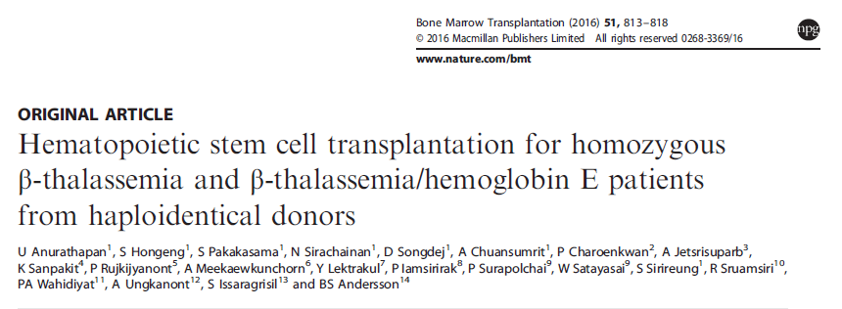

Slide 37
Thirty-one patients received haplo-SCT
The patients’ median age was 10 years (range, 2–20 years)
Only 9 were younger than 7 years
4 patients had homozygous β-thalassemia
27 had β-thalassemia/hemoglobin E
Pretransplant immunosuppressive therapy (PTIS)
two courses fludarabine (Flu) and dexamethasone (Dxm)

Slide 38
Conditioning regimen
rabbit antithymocyte globulin
IV Flu
IV Bu
SCT
T-cell-replete PBPC
The median CD34+ cell dose was 11.6 × 10⁶ cells/kg body weight (range, 4.0–19.0 × 10⁶)
GvHD prophylaxis
cyclophosphamide (Cy) on days SCT +3 and +4 (post-Cy)
on day SCT +5 tacrolimus or sirolimus together with a short course of mycophenolate mofetil

Slide 39
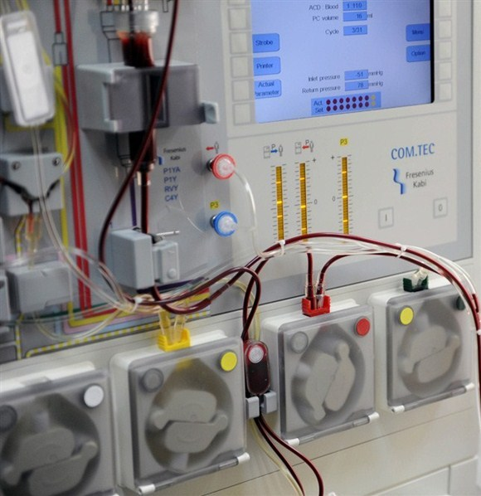
Stem cell collection
Immunomegnetic cell separation- CliniMACS system

Slide 40
Cyclophosphamide post HSC Infusion

Slide 41
Thalassemia (Pre-) Transplant Platform

Slide 42
Results
Twenty-nine patients engrafted with 100% donor chimerism
Two patients suffered primary graft failure
Median time to neutrophil engraftment was 14 days (range, 11–18 days)
Median time to platelet engraftment of 20 × 109/L was 30 days (range, 20–45 days)
Five patients developed mild to moderate, reversible veno-occlusive disease, while nine patients developed acute GvHD grade II
Only five patients developed limited-chronic GvHD
Projected overall and event-free survival rates at 2 years are 95% and 94%, respectively

Slide 43
Supportive care
Antibacterial prophylaxis, together with an antifungal agent, starting on day SCT +5, and continued through the end of immunosuppressive medications
Standard Pneumocystis jiroveci and anti-HSV/VZV prophylaxis for 1 year.
Patients were monitored for CMV, adenovirus and BK-virus reactivation through PCR measurement of viral copy numbers in plasma and urine
Preemptive therapy with ganciclovir was initiated when CMV reactivation was detected and cidofovir was used when adenovirus or BK virus was detected in plasma, or in urine together with clinical symptoms of hemorrhagic cystitis.
Chimerism studies were performed on peripheral blood on the day of engraftment, then every 2 weeks till day SCT +100, monthly until 1 year post-transplantation and then every 3 months

Slide 44
Follow up
First year
hematological and engraftment parameters
Infectious complications
graft versus host disease
Second year
appropriate immunization is necessary if there is no graft versus host disease
Long-term follow up
iron overload
pubertal development
growth and endocrine deficiencies

Slide 45
Conclusion
Considering the combined costs of life-long blood transfusions, chelation and the management of complications, transplantation is certainly a cost-effective option if adequate expertise exist, even in developing countries.
If in the future gene therapy could provide a cure, it needs to demonstrate at least equivalent results in terms of cost/benefit ratio with HSCT

Slide 46
Thank you

